Slide 1



1.C Open Source
you should be able to define and explain open-source and types of licenses

Slide 2



Open-source Software
Anyone can:
Use
Study
Modify
Share

Slide 3
Open-source Software
Benefits:
Control
Training
Security
Stability

Slide 4
Open-source Software
Types of Licenses:
Copyleft
Permissive

Slide 5

Who Develop Open-source Software?

Slide 6
Open-source Software
Licenses:
Copyleft
Permissive

Slide 7
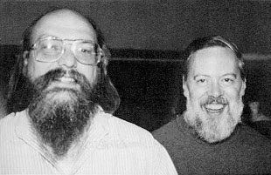
Ken Thompson
the original Unix operating system, B programming language and Go-Lang

Slide 8
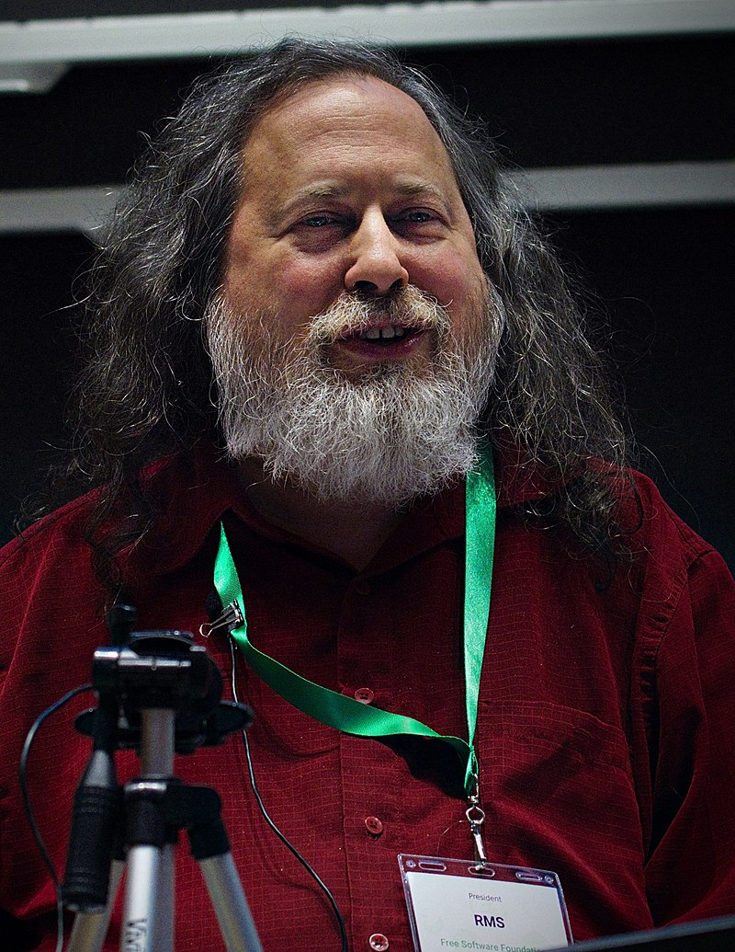
Richard Stallman
launched the GNU Project in September 1983 to write a Unix-like computer operating system composed entirely of free software.

Slide 9
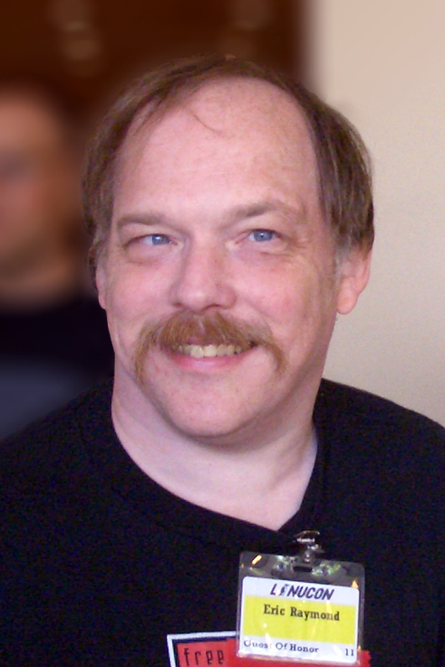
Eric S. Raymond
in 1997, he wrote the essay "The Cathedral and the Bazaar",
He co-founded the Open Source Initiative (OSI) in 1998

Slide 10
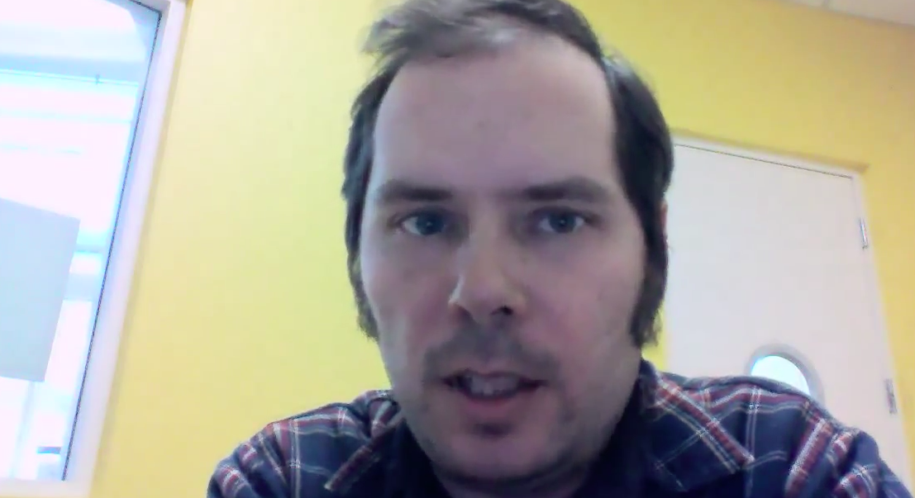
Robert McCool
he author of the original NCSA HTTPd web server later known as the Apache HTTP Server

Slide 11
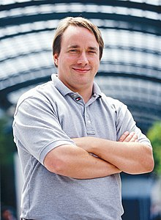
Linus Torvalds
First Linux Kernel 1991

